Slide 1
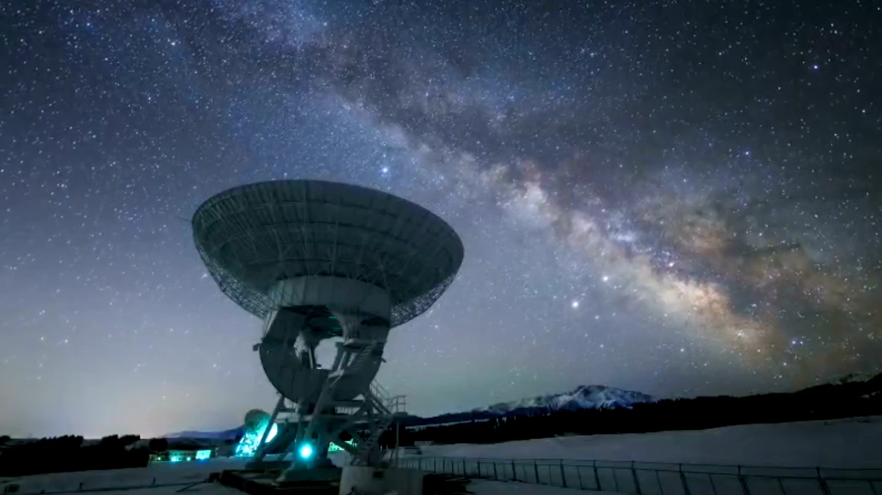
Photometric Analysis of the Night Sky
Muhammad Ahmad Mirza

Slide 2
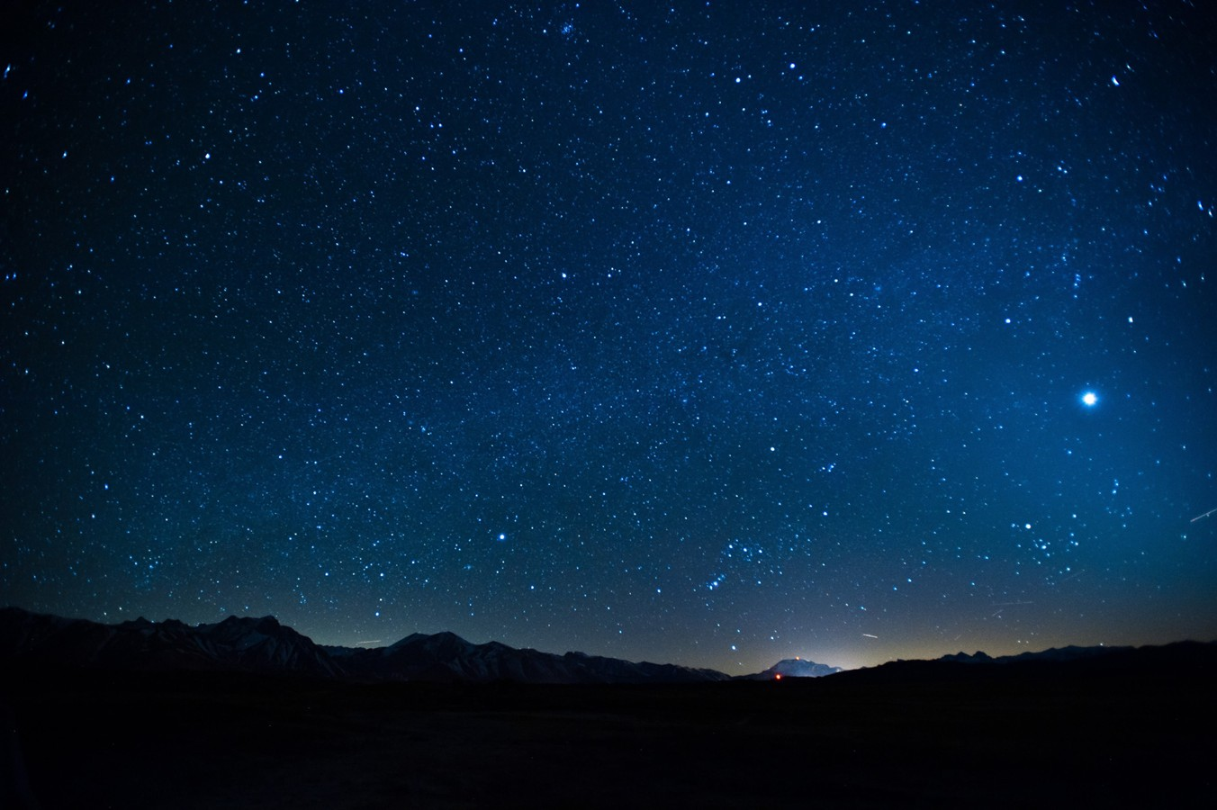
What is Photometry
Definition:
Photometry is the measurement of the brightness (or flux) of astronomical objects, typically in one or more wavelength bands, over time.
In astronomy, this typically refers to:
Absolute photometry: Measuring the actual flux in physical units.
Relative photometry: Measuring the brightness of a target star relative to one or more comparison stars. This is what you're doing

Slide 3

Image Calibration
Flat Field Correction __________ Fixes uneven lighting and dust by normalizing pixel response.
Dark Frame Subtraction _______ Removes thermal noise from long exposures.
Bias Correction ______________ Eliminates electronic readout noise from the sensor.
Image Stacking ______________ Combines images to boost signal and reduce random noise.
Sky Background Subtraction ___ Clears sky glow or light pollution for clean star data.

Slide 4
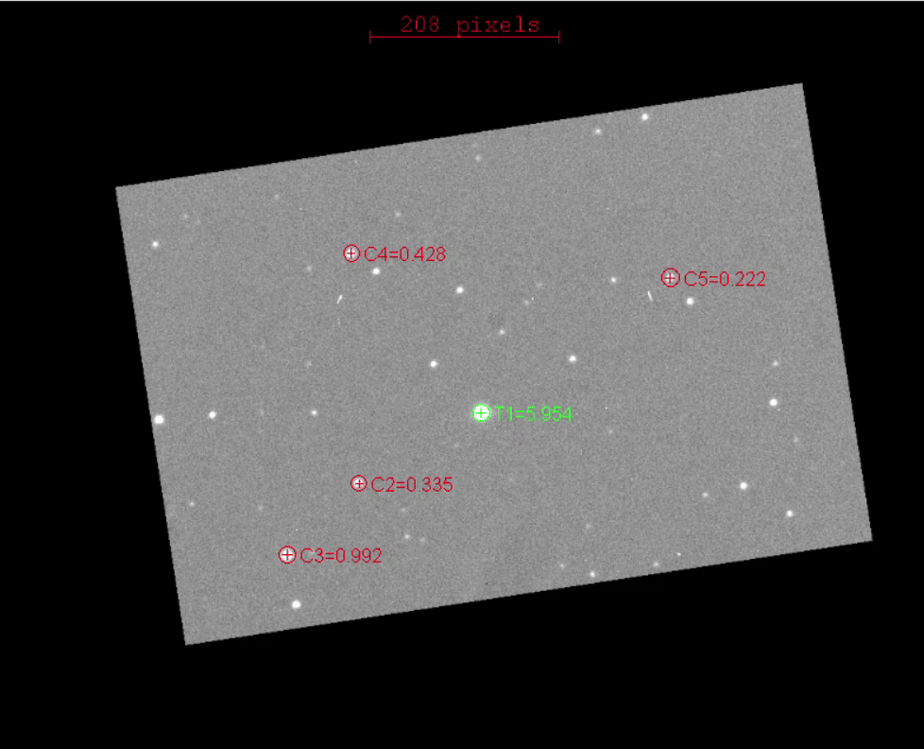
Image stacking
Improves Signal-to-Noise Ratio (SNR)

Slide 5
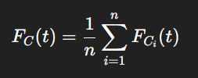
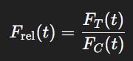
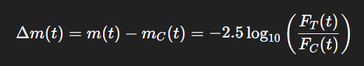

Differential Photometry
Raw Flux of $n^{th}$
star used for comparison
Differential Flux of the same star
Flux of the target star
Conversion to magnitudes

Slide 6
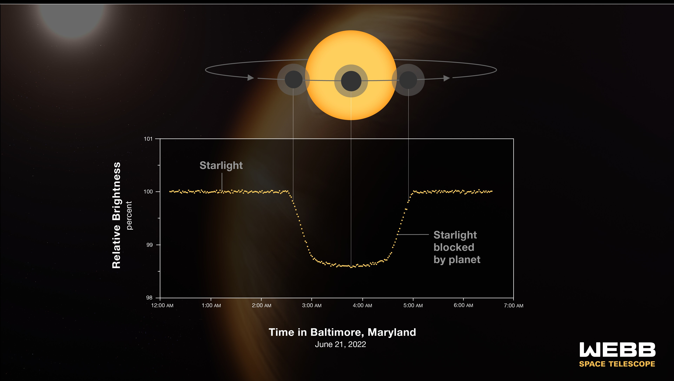
Light Curves

Slide 7
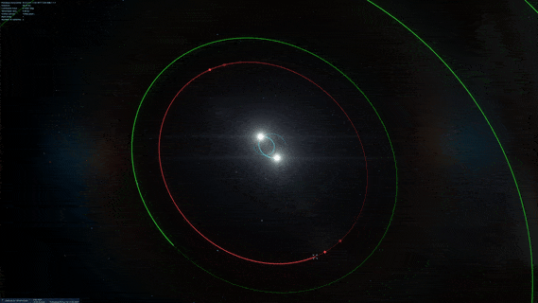

Slide 8
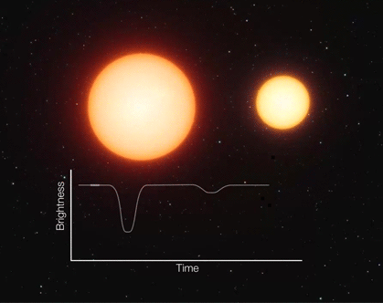
Detached binary Systems

Slide 9
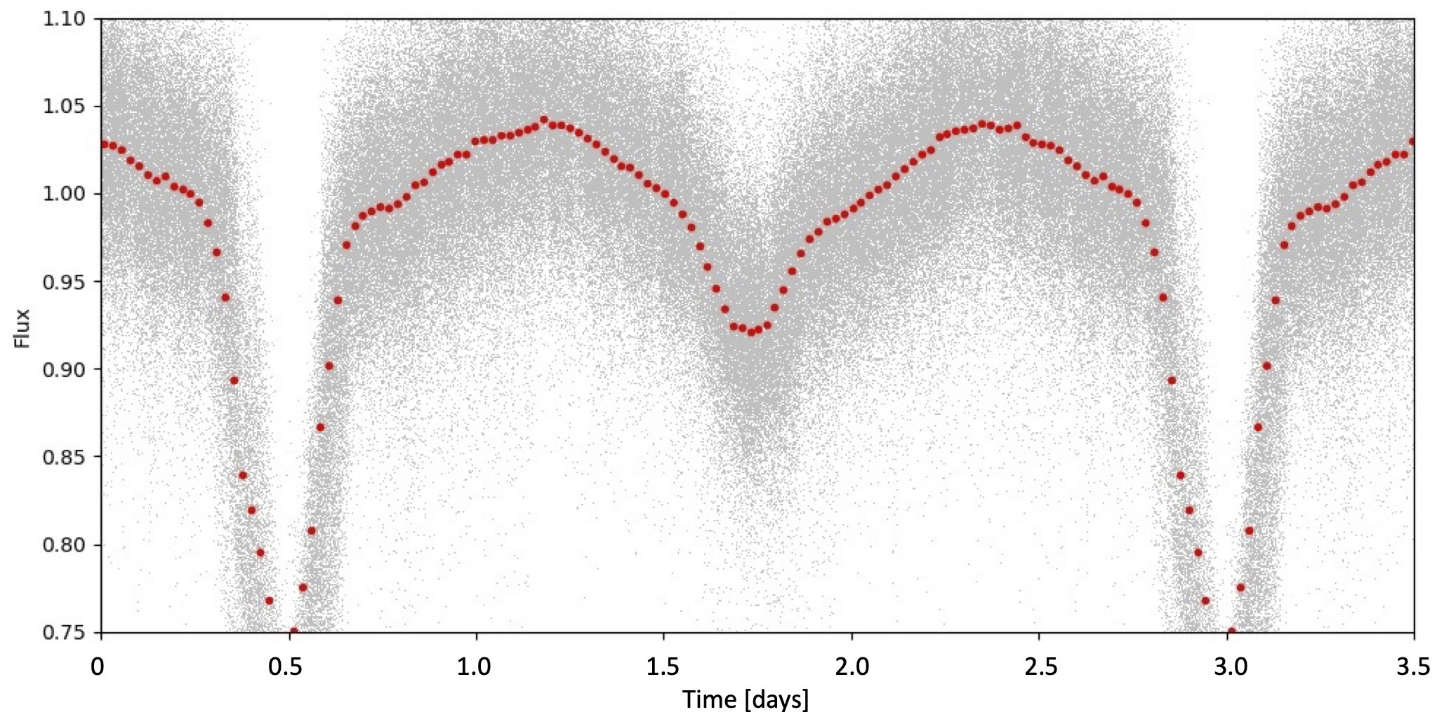
Detached binary systems

Slide 10
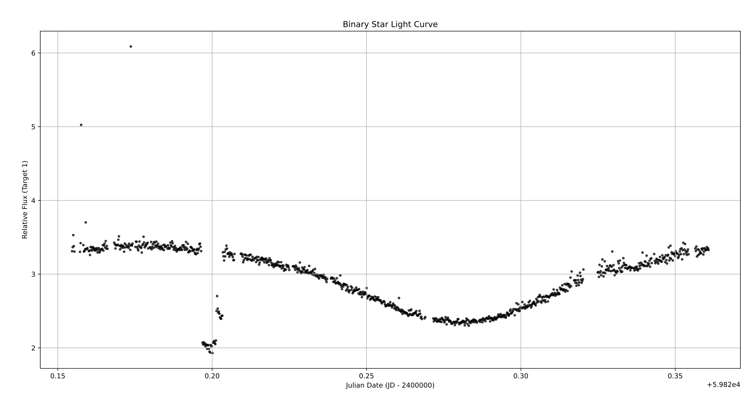
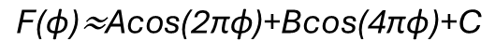
Contact binary System
$$\text{F}\text{(}\text{ϕ}\text{)≈}\text{Acos}\text{(2}\text{πϕ}\text{)+}\text{Bcos}\text{(4}\text{πϕ}\text{)+}\text{C}$$

